Slide 1

Quicken Loans CASE STUDY
By Vamsi Chand Emani

Slide 2

Problem Statement
Introduction:
A European banking institution launched a direct marketing campaign based on phone calls from May 2008 to November 2010
Existing Model Probabilities are provided in the data
Objective:
To build a scalable, reusable & dynamic input data product to evaluate the present marketing campaign & build better models(if applicable)

Slide 3










Approach
Data Generation
Clients Demographics
Data Quality
Insight Generation
Model Evaluation
Modeling
Marketing Campaign
Current Campaign
Campaign Data
EDA
Metrics
ML
Last Campaign
Socio-economic
attributes
Technology Stack:

Slide 4
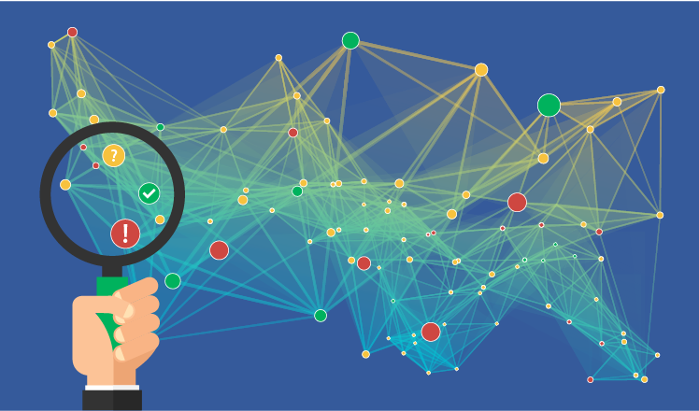
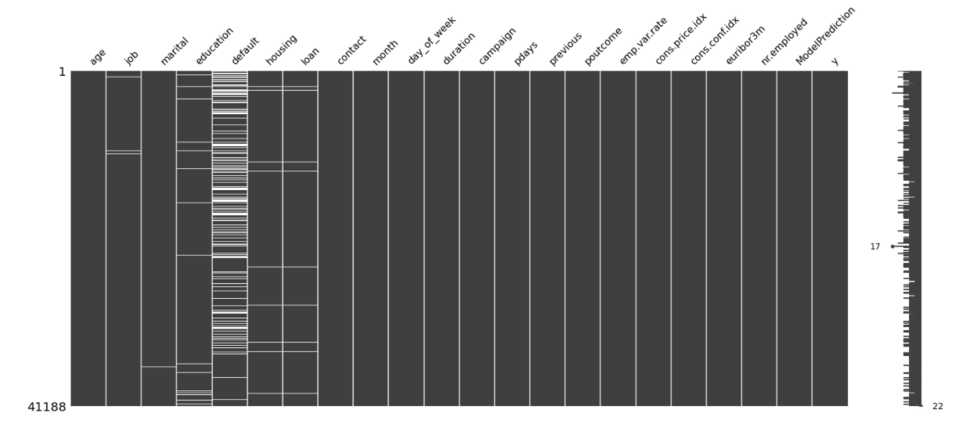

Data
Imbalanced Data
Data Exploration
Data Quality Check
Data Imputation
Subscribed
11.3%
Campaign Data
Not Subscribed
88.7%
(92922,4)

Slide 5
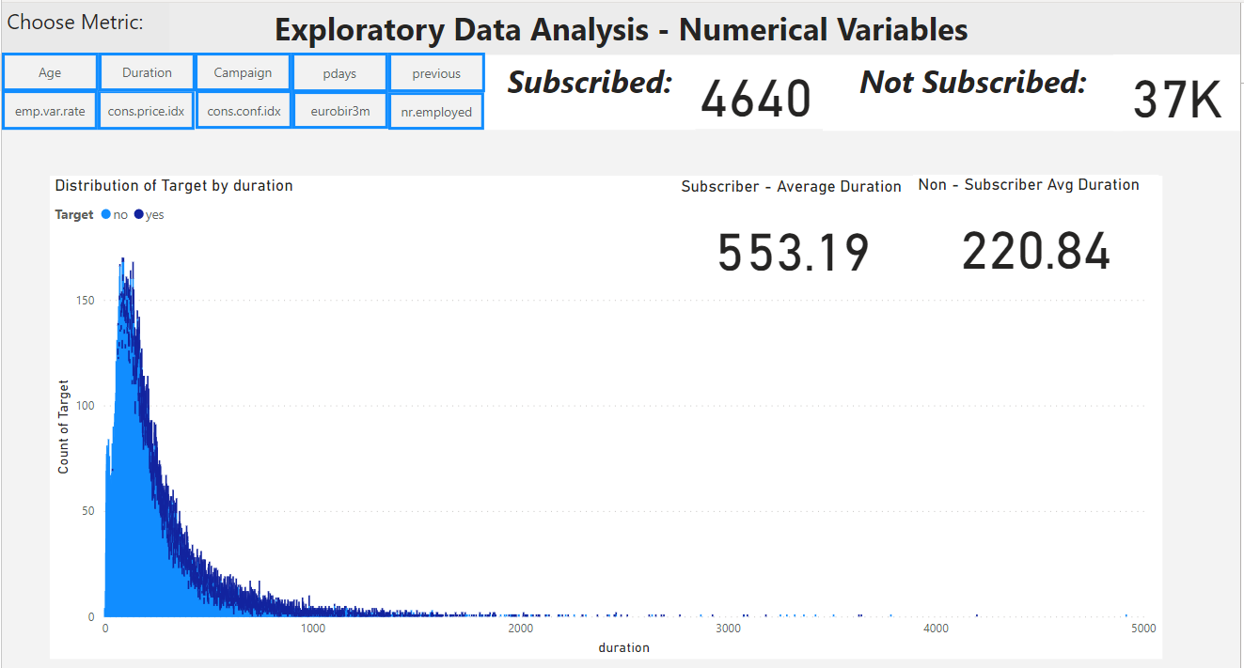
Exploratory Data Analysis
Performed
Univariate Analysis
Bivariate Analysis
Outliers
Correlation Matrix
Dynamic buttons were provided in Power BI for toggling between metrics
Link to Power BI

Slide 6
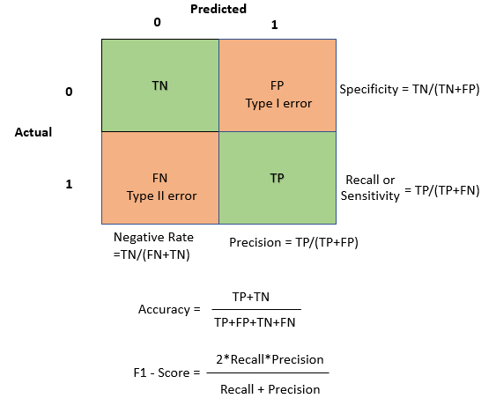


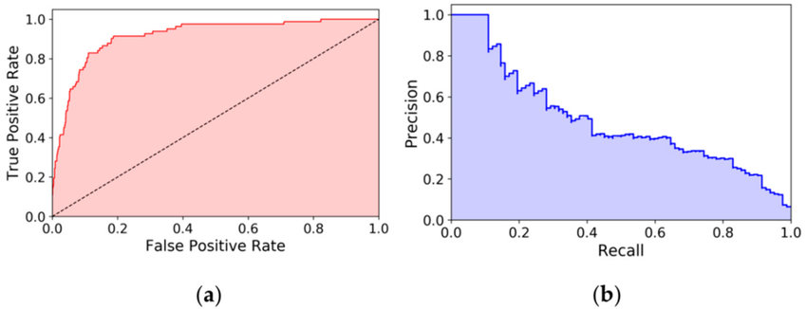

Imbalanced Data – Evaluation Metrics
Accuracy
Sensitivity/Recall
Specificity
Precision
F-beta Measure
ROC – AUC
Precision Recall - AUC

Slide 7
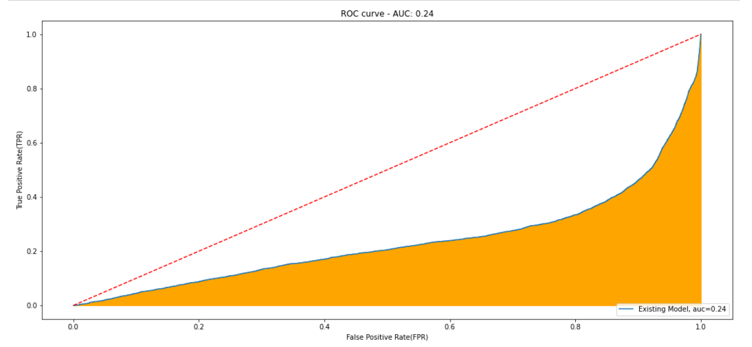
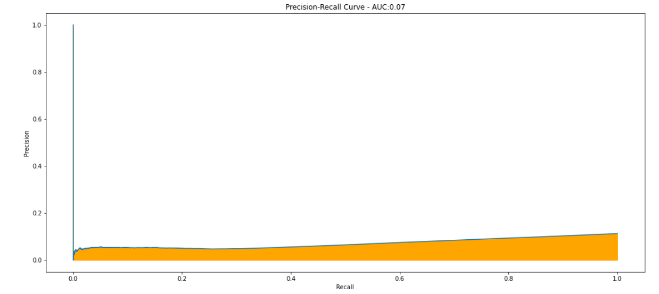
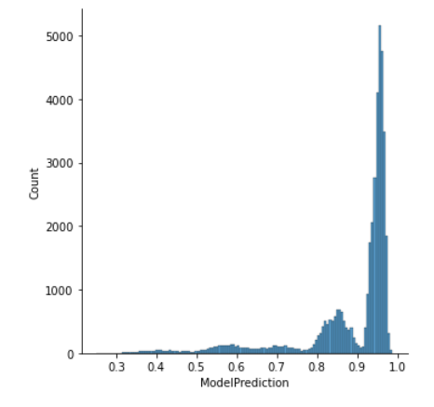
Existing Model Evaluation
Performance of existing model is worse than random classification model

Slide 8
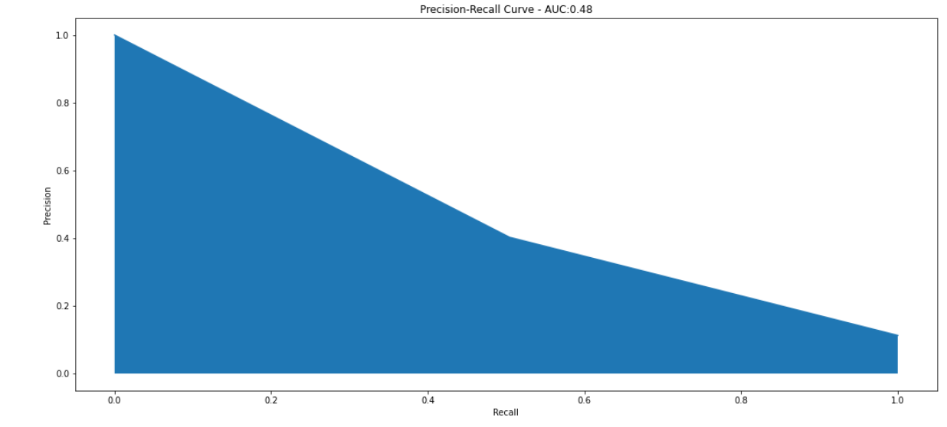
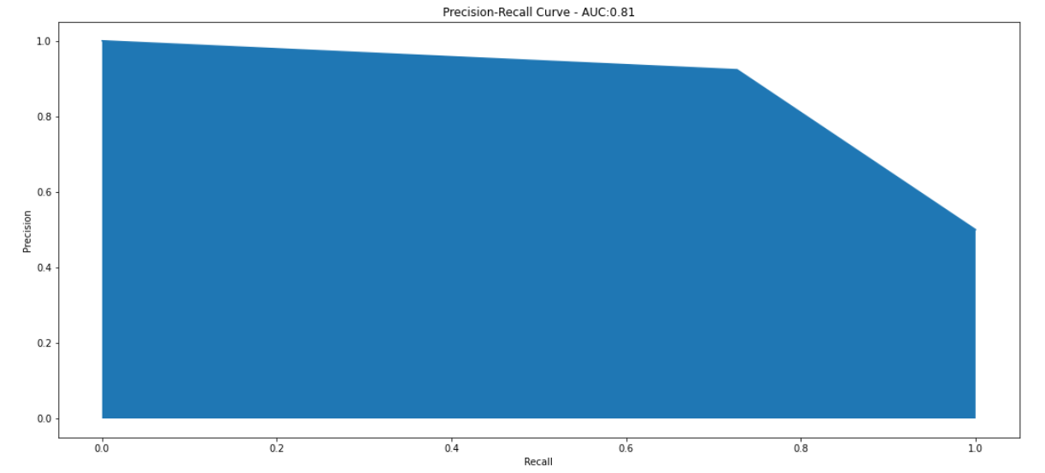
New Model - Random Forest
Over Sampling
Under Sampling
PR AUC = 0.48
PR AUC = 0.81

Slide 9
Existing Model vs Random Forest
Threshold considered : 0.97

Slide 10
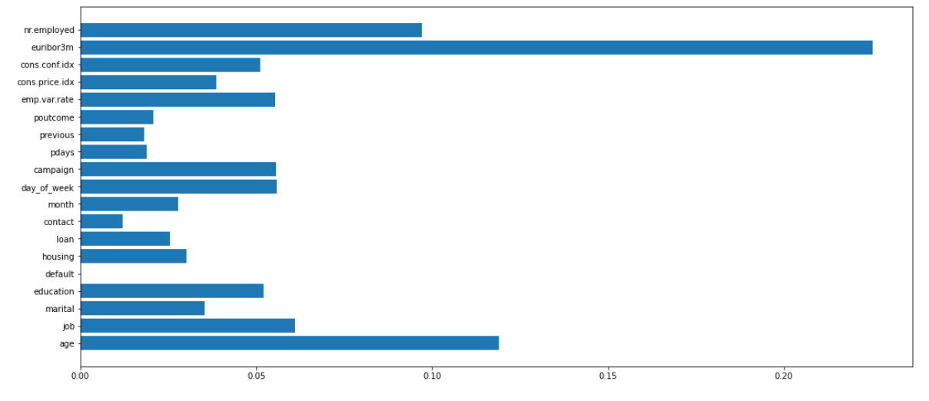
Feature Importance
Key Metrics:
euribor3m
nr.employed
emp.var.rate
age
job

Slide 11
Future Scope
More Data + Quality Data = Better Results. E.g.: More Data on Customer behavior while interacting with the brand
Customer Segmentation, Personalized Marketing, A/B Testing
Omni-Channel Marketing
Advanced techniques like Neural Networks can be used to build the models.
Grid Search & Cross Validation can be applied to find the optimal thresholds
Seasonality of the data can be considered
Combination of over sampling & under sampling can be explored

